Slide 1



INTRODUCTION
PARROT
DESKTOP VOICE ASSISTANCE
By- Vrushali R. Patil
Pratik P. Holkar
Shrinek B Mungari
Desktop voice assistance is used to run machines like laptop or personal computers on your own commands.
Desktop voice assistance is an application program that understand the natural language and voice commands to complete tasks for users.
Desktop voice assistance is used to perform a typical task like showing date & time, managing emails, openings apps etc. on your commands.

Slide 2
Use Case diagram
INTRODUCTION
Desktop voice assistance is used to run machines like laptop or personal computers on your own commands.
Desktop voice assistance is an application program that understand the natural language and voice commands to complete tasks for users.
Desktop voice assistance is used to perform a typical task like showing date & time, managing emails, openings apps etc. on your commands.
PARROT
DESKTOP VOICE ASSISTANCE
By- Vrushali R. Patil
Pratik P. Holkar
Shrinek B Mungari

Slide 3
ER Diagram
Username
Password
Email ID
User
Open
Input
Command
Use Case diagram
INTRODUCTION
Desktop voice assistance is used to run machines like laptop or personal computers on your own commands.
Desktop voice assistance is an application program that understand the natural language and voice commands to complete tasks for users.
Desktop voice assistance is used to perform a typical task like showing date & time, managing emails, openings apps etc. on your commands.
Login
PARROT
Opening
Listening
DESKTOP VOICE ASSISTANCE
Recognising
Processing
Output
By- Vrushali R. Patil
Pratik P. Holkar
Shrinek B Mungari

Slide 4
ER Diagram
Use Case diagram
Database Tables for user table
INTRODUCTION
Desktop voice assistance is used to run machines like laptop or personal computers on your own commands.
Desktop voice assistance is an application program that understand the natural language and voice commands to complete tasks for users.
Desktop voice assistance is used to perform a typical task like showing date & time, managing emails, openings apps etc. on your commands.
Username
Password
PARROT
S.no | Attributes | Data Type | Field Length | Constraint
1 | username | varchar | 30 | Not null
2 | password | varchar | 20 | Not null
3 | Email ID | varchar | 20 | Not null
Email ID
User
Open
DESKTOP VOICE ASSISTANCE
Input
Command
By- Vrushali R. Patil
Pratik P. Holkar
Shrinek B Mungari
Login
Opening
Listening
Recognising
Processing
Output

Slide 5
ER Diagram
Unit Testing For Password
Use Case diagram
Database Tables for user table
PARROT
Test Scenario | Test Data | Expected Results
Enter password in proper format Pattern={ } | Vrushali938# | Strong password is expected.
Enter password in wrong format | 33344455#33 | Please enter valid password .
Blank field |  | Please enter password/This field is compulsory.
S.no | Attributes | Data Type | Field Length | Constraint
1 | username | varchar | 20 | Not null
2 | password | varchar | 8 | Not null
3 | Email ID | varchar | 50 | Not null
DESKTOP VOICE ASSISTANCE
By- Vrushali R. Patil
Pratik P. Holkar
Shrinek B Mungari

Slide 6
ER Diagram
Functional Testing For user input
Unit Testing For Password
Use Case diagram
Database Tables for user table
Test Scenario | Test Data | Expected Result | Actual Result | Remark
Give valid input command | Open google | Opening google | Opening google | Pass
Give invalid invalid input command | Open coding file(the file that does not exit in the system) | The file you have searching Is not present in system | Give command once again | Pass
Not giving input |  | What can I do for you. | It asks for command | Pass
Test Scenario | Test Data | Expected Result | Actual Result | Remark
Give valid input command | Open google | Opening google | Opening google | Pass
PARROT
Test Scenario | Test Data | Expected Results
Enter password in proper format Pattern={^(?=.*[a-z])(?=.*[A-Z])(?=.*\d)(?=.*[!@#$%^&*()]).{8,}$ } | Vrushali938# | Strong password is expected.
Enter password in wrong format | 33344455#33 | Please enter valid password .
Blank field |  | Please enter password/This field is compulsory.
S.no | Attributes | Data Type | Field Length | Constraint
1 | username | varchar | 20 | Not null
2 | password | varchar | 8 | Not null
3 | Email ID | varchar | 50 | Not null
DESKTOP VOICE ASSISTANCE
By- Vrushali R. Patil
Pratik P. Holkar
Shrinek B Mungari
Test Scenario | Test Data | Expected Result | Actual Result | Remark
Give valid input command | Open google | Opening google | Opening google | Pass
Give invalid invalid input command | Open coding file(the file that does not exit in the system) | The file you have searching Is not present in system | Give command once again | Pass
Not giving input |  | What can I do for you. | It asks for command | Pass
Test Scenario | Test Data | Expected Result | Actual Result | Remark

Slide 7
ER Diagram
Functional Testing For user input
Integration Testing for functionality
Unit Testing For Password
Use Case diagram
Database Tables for user table
PARROT
Test Scenario | Test Data | Expected Result | Actual Result | Remark
Give valid input command | Open google | Opening google | Opening google | Pass
Give invalid invalid input command | Open coding file(the file that does not exit in the system) | The file you have searching Is not present in system | Give command once again | Pass
Not giving input |  | What can I do for you. | It asks for command | Pass
Test Scenario | Test Data | Expected Result | Actual Result | Remark
Test Scenario | Test Data | Expected Results
Enter password in proper format Pattern={ } | Vrushali938# | Strong password is expected.
Enter password in wrong format | 33344455#33 | Please enter valid password .
Blank field |  | Please enter password/This field is compulsory.
S.no | Attributes | Data Type | Field Length | Constraint
1 | username | varchar | 20 | Not null
2 | password | varchar | 8 | Not null
3 | Email ID | varchar | 50 | Not null
DESKTOP VOICE ASSISTANCE
Module | Test data | Expected results | Actual result | Remark
Login | Login using valid username and password/login using invalid username and password | Loging successful Loging unsuccessful | Loging successful | pass
Input | Valid input with clear voice/invalid input with noise | Recognising commands Please say that again | Recognising commands | pass
Output |  | Executing tasks | Executing tasks | pass
Module | Test data | Expected results | Actual result | Remark
By- Vrushali R. Patil
Pratik P. Holkar
Shrinek B Mungari

Slide 8
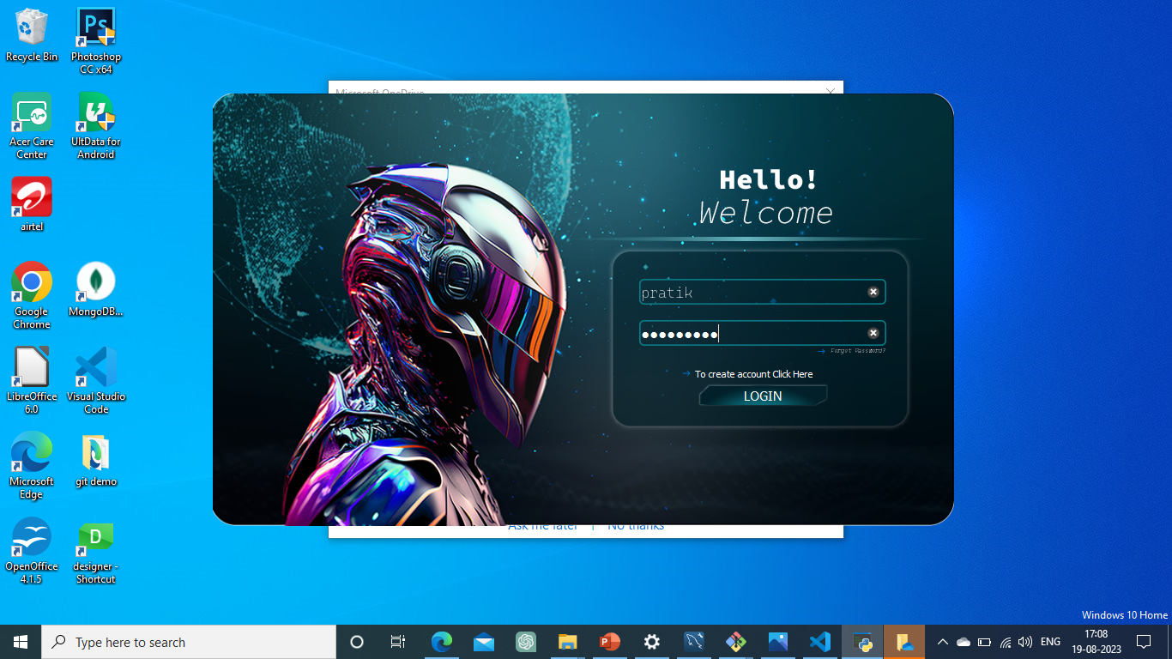
ER Diagram
Thank You
Positive Testing
Integration Testing for functionality
Functional Testing For user input
Unit Testing For Password
Use Case diagram
Database Tables for user table
Module | Test data | Expected results | Actual result | Remark
Login | Login using valid username and password/login using invalid username and password | Loging successful Loging unsuccessful | Loging successful | pass
Input | Valid input with clear voice/invalid input with noise | Recognising commands Please say that again | Recognising commands | pass
Output |  | Executing tasks | Executing tasks | pass
Module | Test data | Expected results | Actual result | Remark
PARROT
Test Scenario | Test Data | Expected Result | Actual Result | Remark
Give valid input command | Open google | Opening google | Opening google | Pass
Give invalid invalid input command | Open coding file(the file that does not exit in the system) | The file you have searching Is not present in system | Give command once again | Pass
Not giving input |  | What can I do for you. | It asks for command | Pass
Test Scenario | Test Data | Expected Result | Actual Result | Remark
Test Scenario | Test Data | Expected Results
Enter password in proper format Pattern={ } | Vrushali938# | Strong password is expected.
Enter password in wrong format | 33344455#33 | Please enter valid password .
Blank field |  | Please enter password/This field is compulsory.
S.no | Attributes | Data Type | Field Length | Constraint
1 | username | varchar | 20 | Not null
2 | password | varchar | 8 | Not null
3 | Email ID | varchar | 50 | Not null
DESKTOP VOICE ASSISTANCE
By- Vrushali R. Patil
Pratik P. Holkar
Shrinek B Mungari

Slide 9
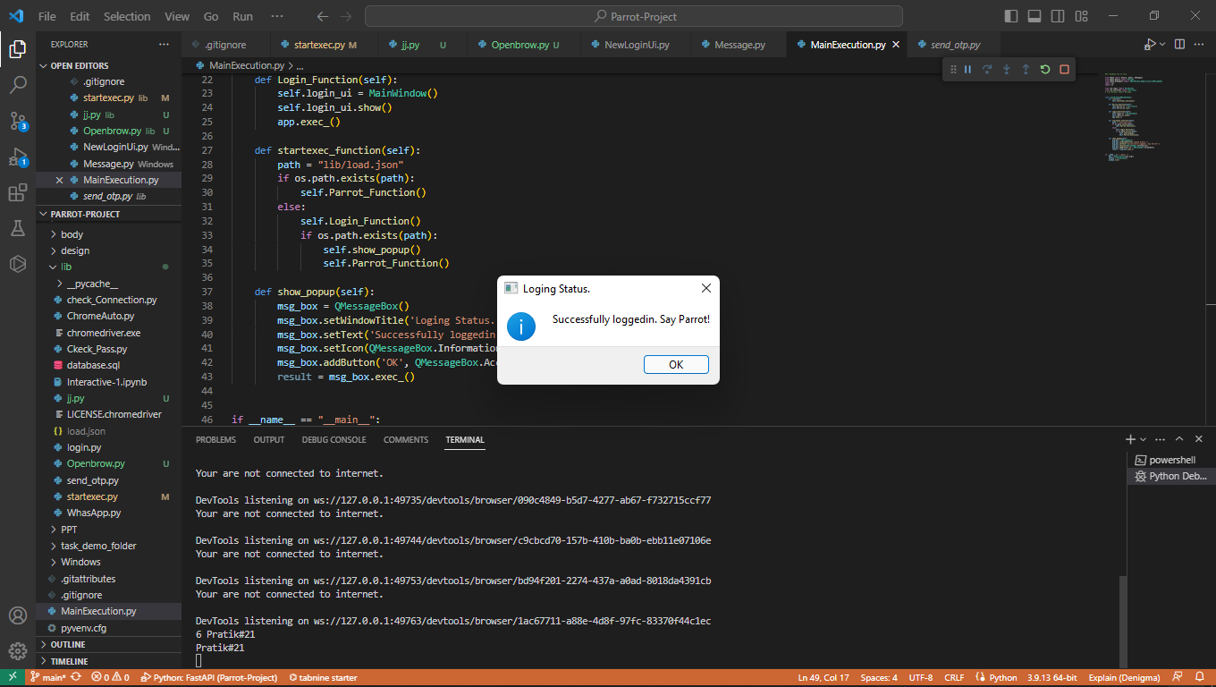
ER Diagram
Thank You
Positive Testing
Functional Testing For user input
Unit Testing For Password
Use Case diagram
Database Tables for user table
Module | Test data | Expected results | Actual result | Remark
Login | Login using valid username and password/login using invalid username and password | Loging successful Loging unsuccessful | Loging successful | pass
Input | Valid input with clear voice/invalid input with noise | Recognising commands Please say that again | Recognising commands | pass
Output |  | Executing tasks | Executing tasks | pass
Module | Test data | Expected results | Actual result | Remark
Module | Test data | Expected results | Actual result | Remark
Login | Login using valid username and password/login using invalid username and password | Loging successful Loging unsuccessful | Loging successful | pass
Input | Valid input with clear voice/invalid input with noise | Recognising commands Please say that again | Recognising commands | pass
Output |  | Executing tasks | Executing tasks | pass
Module | Test data | Expected results | Actual result | Remark
Login | Login using valid username and password/login using invalid username and password | Loging successful Loging unsuccessful | Loging successful | pass
PARROT
Test Scenario | Test Data | Expected Results
Enter password in proper format Pattern={ } | Vrushali938# | Strong password is expected.
Enter password in wrong format | 33344455#33 | Please enter valid password .
Blank field |  | Please enter password/This field is compulsory.
S.no | Attributes | Data Type | Field Length | Constraint
1 | username | varchar | 20 | Not null
2 | password | varchar | 8 | Not null
3 | Email ID | varchar | 50 | Not null
DESKTOP VOICE ASSISTANCE
By- Vrushali R. Patil
Pratik P. Holkar
Shrinek B Mungari

Slide 10
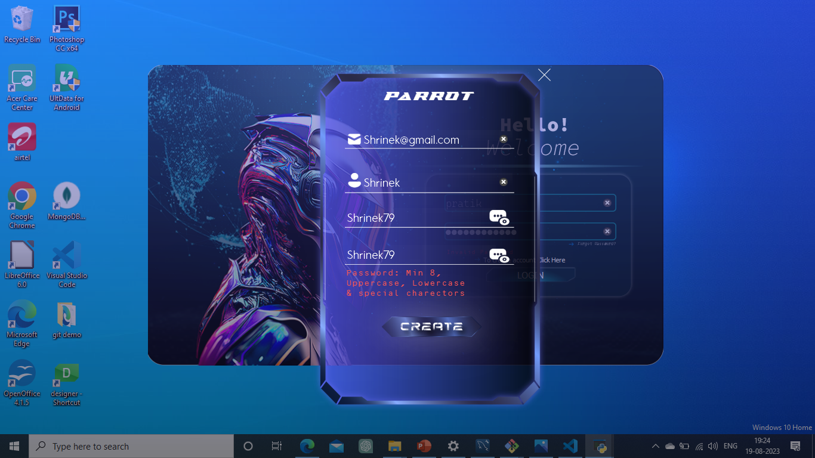
ER Diagram
Thank You
Negative Testing
Positive Testing
Positive Testing
Functional Testing For user input
Unit Testing For Password
Use Case diagram
Database Tables for user table
Module | Test data | Expected results | Actual result | Remark
Login | Login using valid username and password/login using invalid username and password | Loging successful Loging unsuccessful | Loging successful | pass
Input | Valid input with clear voice/invalid input with noise | Recognising commands Please say that again | Recognising commands | pass
Output |  | Executing tasks | Executing tasks | pass
Module | Test data | Expected results | Actual result | Remark
Login | Login using valid username and password/login using invalid username and password | Loging successful Loging unsuccessful | Loging successful | pass
Test Scenario | Test Data | Expected Result | Actual Result | Remark
Give valid input command | Open google | Opening google | Opening google | Pass
Give invalid invalid input command | Open coding file(the file that does not exit in the system) | The file you have searching Is not present in system | Give command once again | Pass
Not giving input |  | What can I do for you. | It asks for command | Pass
Test Scenario | Test Data | Expected Result | Actual Result | Remark
Give valid input command | Open google | Opening google | Opening google | Pass
PARROT
Test Scenario | Test Data | Expected Results
Enter password in proper format Pattern={ } | Vrushali938# | Strong password is expected.
Enter password in wrong format | 33344455#33 | Please enter valid password .
Blank field |  | Please enter password/This field is compulsory.
S.no | Attributes | Data Type | Field Length | Constraint
1 | username | varchar | 20 | Not null
2 | password | varchar | 8 | Not null
3 | Email ID | varchar | 50 | Not null
DESKTOP VOICE ASSISTANCE
By- Vrushali R. Patil
Pratik P. Holkar
Shrinek B Mungari

Slide 11
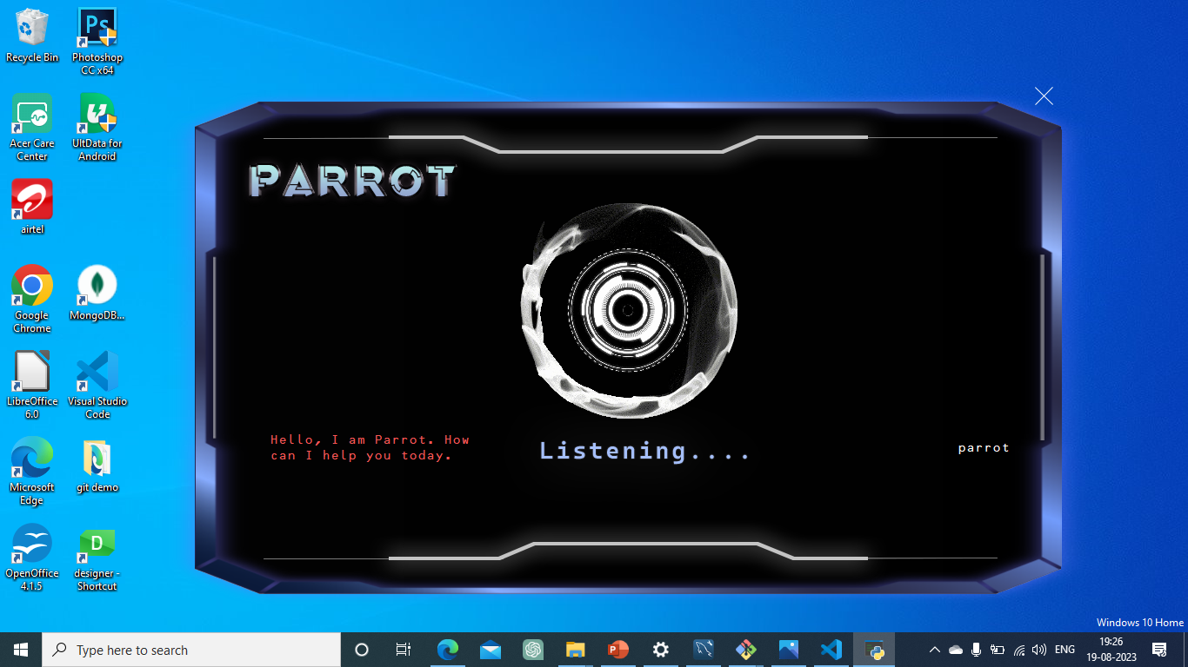
ER Diagram
Positive Testing
Thank You
Listening Interface
Positive Testing
Negative Testing
Functional Testing For user input
Unit Testing For Password
Use Case diagram
Database Tables for user table
Module | Test data | Expected results | Actual result | Remark
Login | Login using valid username and password/login using invalid username and password | Loging successful Loging unsuccessful | Loging successful | pass
Input | Valid input with clear voice/invalid input with noise | Recognising commands Please say that again | Recognising commands | pass
Output |  | Executing tasks | Executing tasks | pass
Module | Test data | Expected results | Actual result | Remark
Login | Login using valid username and password/login using invalid username and password | Loging successful Loging unsuccessful | Loging successful | pass
Test Scenario | Test Data | Expected Result | Actual Result | Remark
Give valid input command | Open google | Opening google | Opening google | Pass
Give invalid invalid input command | Open coding file(the file that does not exit in the system) | The file you have searching Is not present in system | Give command once again | Pass
Not giving input |  | What can I do for you. | It asks for command | Pass
Test Scenario | Test Data | Expected Result | Actual Result | Remark
Give valid input command | Open google | Opening google | Opening google | Pass
PARROT
Test Scenario | Test Data | Expected Results
Enter password in proper format Pattern={ } | Vrushali938# | Strong password is expected.
Enter password in wrong format | 33344455#33 | Please enter valid password .
Blank field |  | Please enter password/This field is compulsory.
S.no | Attributes | Data Type | Field Length | Constraint
1 | username | varchar | 20 | Not null
2 | password | varchar | 8 | Not null
3 | Email ID | varchar | 50 | Not null
DESKTOP VOICE ASSISTANCE
By- Vrushali R. Patil
Pratik P. Holkar
Shrinek B Mungari

Slide 12
ER Diagram
Recognizing Interface
Thank You
Negative Testing
Listening Interface
Functional Testing For user input
Unit Testing For Password
Use Case diagram
Database Tables for user table
Module | Test data | Expected results | Actual result | Remark
Login | Login using valid username and password/login using invalid username and password | Loging successful Loging unsuccessful | Loging successful | pass
Input | Valid input with clear voice/invalid input with noise | Recognising commands Please say that again | Recognising commands | pass
Output |  | Executing tasks | Executing tasks | pass
Module | Test data | Expected results | Actual result | Remark
Login | Login using valid username and password/login using invalid username and password | Loging successful Loging unsuccessful | Loging successful | pass
Test Scenario | Test Data | Expected Result | Actual Result | Remark
Give valid input command | Open google | Opening google | Opening google | Pass
Give invalid invalid input command | Open coding file(the file that does not exit in the system) | The file you have searching Is not present in system | Give command once again | Pass
Not giving input |  | What can I do for you. | It asks for command | Pass
Test Scenario | Test Data | Expected Result | Actual Result | Remark
Give valid input command | Open google | Opening google | Opening google | Pass
PARROT
Test Scenario | Test Data | Expected Results
Enter password in proper format Pattern={ } | Vrushali938# | Strong password is expected.
Enter password in wrong format | 33344455#33 | Please enter valid password .
Blank field |  | Please enter password/This field is compulsory.
S.no | Attributes | Data Type | Field Length | Constraint
1 | username | varchar | 20 | Not null
2 | password | varchar | 8 | Not null
3 | Email ID | varchar | 50 | Not null
DESKTOP VOICE ASSISTANCE
By- Vrushali R. Patil
Pratik P. Holkar
Shrinek B Mungari

Slide 13
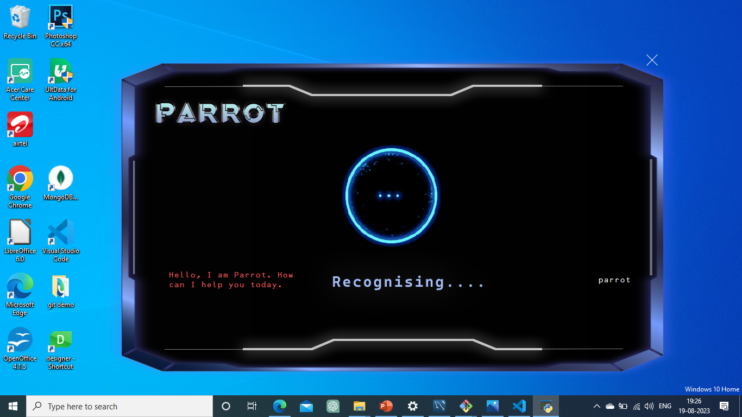
ER Diagram
Thank You
Coding Explanation
Recognizing Interface
Listening Interface
Functional Testing For user input
Unit Testing For Password
Use Case diagram
Database Tables for user table
Module | Test data | Expected results | Actual result | Remark
Login | Login using valid username and password/login using invalid username and password | Loging successful Loging unsuccessful | Loging successful | pass
Input | Valid input with clear voice/invalid input with noise | Recognising commands Please say that again | Recognising commands | pass
Output |  | Executing tasks | Executing tasks | pass
Module | Test data | Expected results | Actual result | Remark
Login | Login using valid username and password/login using invalid username and password | Loging successful Loging unsuccessful | Loging successful | pass
Test Scenario | Test Data | Expected Result | Actual Result | Remark
Give valid input command | Open google | Opening google | Opening google | Pass
Give invalid invalid input command | Open coding file(the file that does not exit in the system) | The file you have searching Is not present in system | Give command once again | Pass
Not giving input |  | What can I do for you. | It asks for command | Pass
Test Scenario | Test Data | Expected Result | Actual Result | Remark
Give valid input command | Open google | Opening google | Opening google | Pass
PARROT
Test Scenario | Test Data | Expected Results
Enter password in proper format Pattern={ } | Vrushali938# | Strong password is expected.
Enter password in wrong format | 33344455#33 | Please enter valid password .
Blank field |  | Please enter password/This field is compulsory.
S.no | Attributes | Data Type | Field Length | Constraint
1 | username | varchar | 20 | Not null
2 | password | varchar | 8 | Not null
3 | Email ID | varchar | 50 | Not null
DESKTOP VOICE ASSISTANCE
By- Vrushali R. Patil
Pratik P. Holkar
Shrinek B Mungari

Slide 14
ER Diagram
Thank You
Coding Explanation
Functional Testing For user input
Unit Testing For Password
Use Case diagram
Database Tables for user table
import webbrowser as web
import time
import keyboard
import pyautogui as pg
def whatsapp(name,message):
name = name
message = message
# Compose the URL to open the chat with the recipient
url = f'https://web.whatsapp.com/'
# Open the chat with the recipient in WhatsApp Web
web.open(url)
# Wait for the chat to load
time.sleep(20)
pg.click(33,182)
time.sleep(2)
Module | Test data | Expected results | Actual result | Remark
Login | Login using valid username and password/login using invalid username and password | Loging successful Loging unsuccessful | Loging successful | pass
Input | Valid input with clear voice/invalid input with noise | Recognising commands Please say that again | Recognising commands | pass
Output |  | Executing tasks | Executing tasks | pass
Module | Test data | Expected results | Actual result | Remark
Login | Login using valid username and password/login using invalid username and password | Loging successful Loging unsuccessful | Loging successful | pass
Test Scenario | Test Data | Expected Result | Actual Result | Remark
Give valid input command | Open google | Opening google | Opening google | Pass
Give invalid invalid input command | Open coding file(the file that does not exit in the system) | The file you have searching Is not present in system | Give command once again | Pass
Not giving input |  | What can I do for you. | It asks for command | Pass
Test Scenario | Test Data | Expected Result | Actual Result | Remark
Give valid input command | Open google | Opening google | Opening google | Pass
PARROT
Test Scenario | Test Data | Expected Results
Enter password in proper format Pattern={ } | Vrushali938# | Strong password is expected.
Enter password in wrong format | 33344455#33 | Please enter valid password .
Blank field |  | Please enter password/This field is compulsory.
S.no | Attributes | Data Type | Field Length | Constraint
1 | username | varchar | 20 | Not null
2 | password | varchar | 8 | Not null
3 | Email ID | varchar | 50 | Not null
DESKTOP VOICE ASSISTANCE
By- Vrushali R. Patil
Pratik P. Holkar
Shrinek B Mungari

Slide 15
ER Diagram
Thank You
Coding Explanation
Functional Testing For user input
Unit Testing For Password
Use Case diagram
Database Tables for user table
# keyboard.write(message)
# Press Enter to send the message
keyboard.write(name)
time.sleep(1)
keyboard.press('enter’)
time.sleep(1)
keyboard.write(message)
time.sleep(1)
keyboard.press('enter')
Module | Test data | Expected results | Actual result | Remark
Login | Login using valid username and password/login using invalid username and password | Loging successful Loging unsuccessful | Loging successful | pass
Input | Valid input with clear voice/invalid input with noise | Recognising commands Please say that again | Recognising commands | pass
Output |  | Executing tasks | Executing tasks | pass
Module | Test data | Expected results | Actual result | Remark
Login | Login using valid username and password/login using invalid username and password | Loging successful Loging unsuccessful | Loging successful | pass
Test Scenario | Test Data | Expected Result | Actual Result | Remark
Give valid input command | Open google | Opening google | Opening google | Pass
Give invalid invalid input command | Open coding file(the file that does not exit in the system) | The file you have searching Is not present in system | Give command once again | Pass
Not giving input |  | What can I do for you. | It asks for command | Pass
Test Scenario | Test Data | Expected Result | Actual Result | Remark
Give valid input command | Open google | Opening google | Opening google | Pass
PARROT
Test Scenario | Test Data | Expected Results
Enter password in proper format Pattern={ } | Vrushali938# | Strong password is expected.
Enter password in wrong format | 33344455#33 | Please enter valid password .
Blank field |  | Please enter password/This field is compulsory.
S.no | Attributes | Data Type | Field Length | Constraint
1 | username | varchar | 20 | Not null
2 | password | varchar | 8 | Not null
3 | Email ID | varchar | 50 | Not null
DESKTOP VOICE ASSISTANCE
By- Vrushali R. Patil
Pratik P. Holkar
Shrinek B Mungari

Slide 16
ER Diagram
Thank You
Coding Explanation
Functional Testing For user input
Unit Testing For Password
Use Case diagram
Database Tables for user table
elif "whatsapp" in self.query:
speak("Ok, Tell me their WhatsApp number or name .")
while True:
def Number():
num = takeCommand().lower()
num = num.replace(" ","")
num = re.findall("\d{10}",num)
return num
self.num = Number()
if not self.num:
speak("Repeate that again.")
else:
self.num = self.num[0]
speak("What message do you want to send?")
self.msg = takeCommand().lower()
if "none" != self.msg:
whatsapp(self.num, self.msg)
break
else:
speak("Say that again.")
Module | Test data | Expected results | Actual result | Remark
Login | Login using valid username and password/login using invalid username and password | Loging successful Loging unsuccessful | Loging successful | pass
Input | Valid input with clear voice/invalid input with noise | Recognising commands Please say that again | Recognising commands | pass
Output |  | Executing tasks | Executing tasks | pass
Module | Test data | Expected results | Actual result | Remark
Login | Login using valid username and password/login using invalid username and password | Loging successful Loging unsuccessful | Loging successful | pass
Test Scenario | Test Data | Expected Result | Actual Result | Remark
Give valid input command | Open google | Opening google | Opening google | Pass
Give invalid invalid input command | Open coding file(the file that does not exit in the system) | The file you have searching Is not present in system | Give command once again | Pass
Not giving input |  | What can I do for you. | It asks for command | Pass
Test Scenario | Test Data | Expected Result | Actual Result | Remark
Give valid input command | Open google | Opening google | Opening google | Pass
PARROT
Test Scenario | Test Data | Expected Results
Enter password in proper format Pattern={ } | Vrushali938# | Strong password is expected.
Enter password in wrong format | 33344455#33 | Please enter valid password .
Blank field |  | Please enter password/This field is compulsory.
S.no | Attributes | Data Type | Field Length | Constraint
1 | username | varchar | 20 | Not null
2 | password | varchar | 8 | Not null
3 | Email ID | varchar | 50 | Not null
DESKTOP VOICE ASSISTANCE
By- Vrushali R. Patil
Pratik P. Holkar
Shrinek B Mungari

Slide 17
ER Diagram
# keyboard.write(message)
# Press Enter to send the message
keyboard.write(name)
time.sleep(1)
keyboard.press('enter')
time.sleep(1)
keyboard.write(message)
time.sleep(1)
keyboard.press('enter')
if __name__=='__main__':
whatsapp('9886949323', 'Hello, this is an automated message')
import pyautogui
import time
Coding Explanation
Functional Testing For user input
Thank You
Unit Testing For Password
Use Case diagram
Database Tables for user table
Test Scenario | Test Data | Expected Result | Actual Result | Remark
Give valid input command | Open google | Opening google | Opening google | Pass
Give invalid invalid input command | Open coding file(the file that does not exit in the system) | The file you have searching Is not present in system | Give command once again | Pass
Not giving input |  | What can I do for you. | It asks for command | Pass
Test Scenario | Test Data | Expected Result | Actual Result | Remark
Give valid input command | Open google | Opening google | Opening google | Pass
PARROT
Test Scenario | Test Data | Expected Results
Enter password in proper format Pattern={ } | Vrushali938# | Strong password is expected.
Enter password in wrong format | 33344455#33 | Please enter valid password .
Blank field |  | Please enter password/This field is compulsory.
S.no | Attributes | Data Type | Field Length | Constraint
1 | username | varchar | 20 | Not null
2 | password | varchar | 8 | Not null
3 | Email ID | varchar | 50 | Not null
DESKTOP VOICE ASSISTANCE
By- Vrushali R. Patil
Pratik P. Holkar
Shrinek B Mungari

